Slide 1
Week 4 Snapshot: Data Readiness & Fine-Tuning Pipeline
5 datasets cleaned, canonicalised, lightly augmented → unified Alpaca-style schema (instruction, input, output, source, id, task).
Deterministic merge → dedup → shuffle → split (80/10/10, seed=42); labelled sets up-weighted in val/test.
Orchestrated HPC upload + verification; checksums recorded; spot-checks on split integrity.
LoRA/QLoRA training script prepared with prompt masking, eval hooks, early stopping, and logging.
Artifacts: processed JSONLs, training logs/plots, configs, and scripts captured for reproducibility.
Phase 1 prototype + UI medical web-app. Integrating Gemini + CoT + Multimodal. Dummy placeholders for semantic retrieval.

Slide 2
Fine-Tuning Techniques Implemented
Prompt Masking
PEFT LoRA / optional QLoRA (NF4)
Schedulers
(labels = −100 on prompt tokens) to learn only the answer.
(linear/cosine), warmup, early stopping (patience), periodic eval/save.
Configurable target modules; gradient checkpointing; bf16/fp16.
Evaluation Hooks
Training Harness
Deterministic gen sanity checks; quick Y/N/Maybe proxy; full loss tracking.
Robust JSONL ingest, dynamic padding, tokenizer fixes, max_len=2048; reproducible CLI.

Slide 3
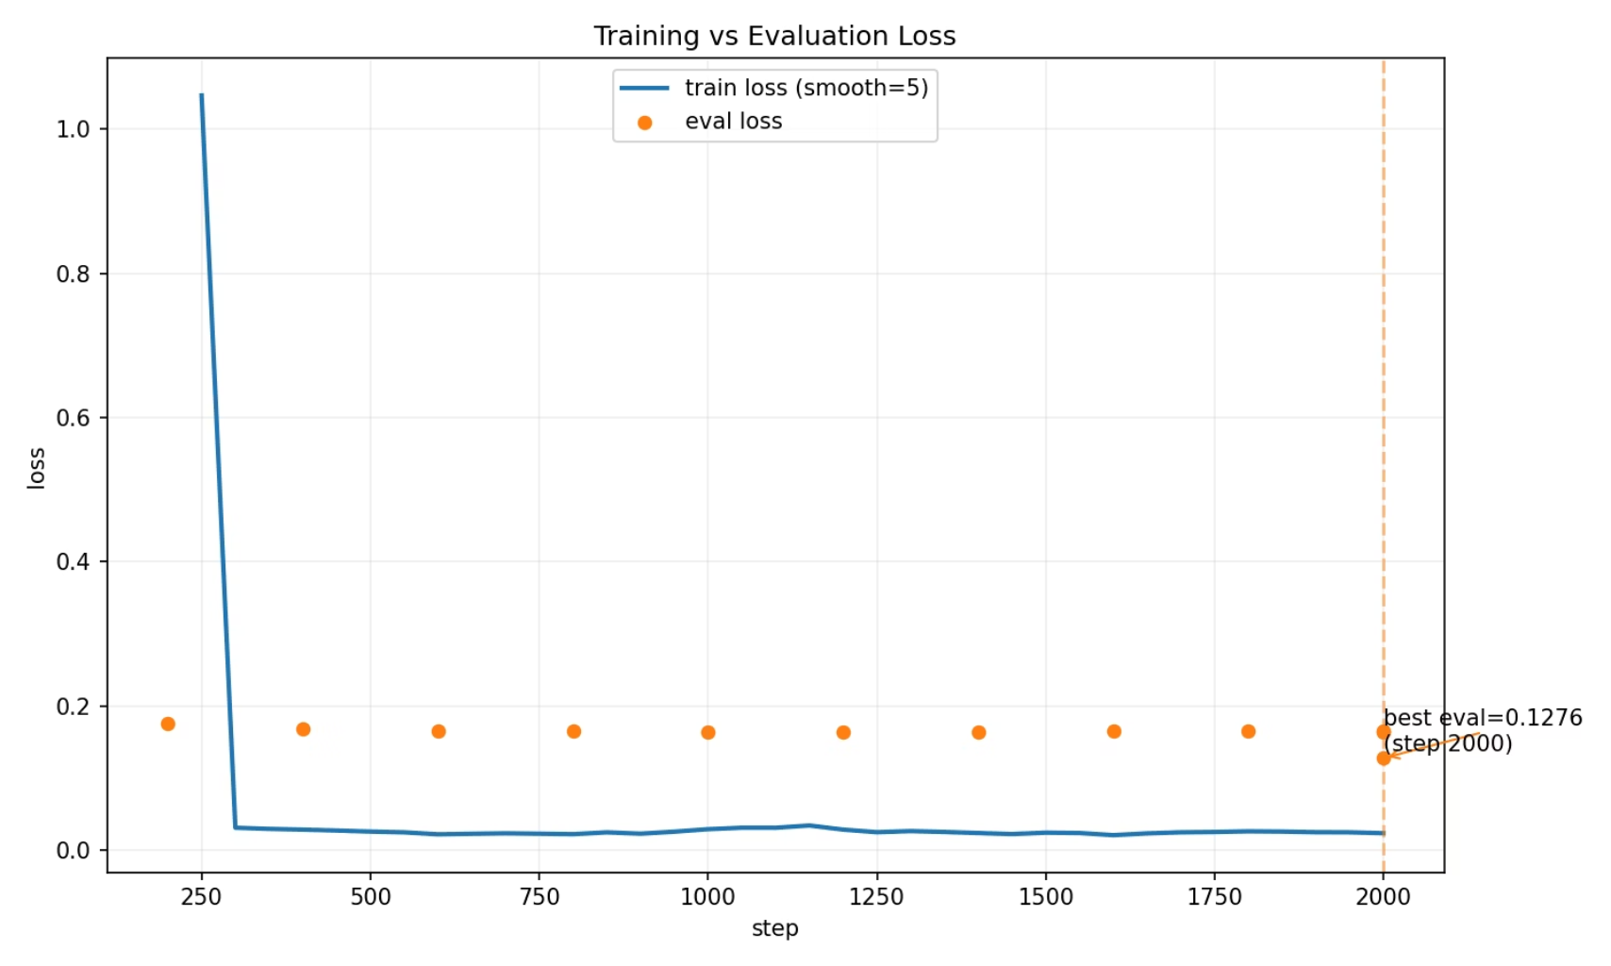
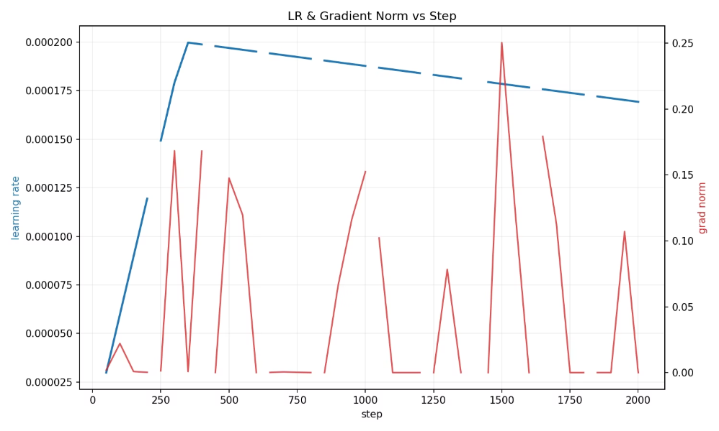
Fine-Tuning Outcomes (Run Summary)
Progress
Loss
2,000 steps, eval every 200; max epoch ≈ 0.537; runtime ~77,701s (~21.6h); throughput ~0.144 steps/s (train) & ~2.055 samples/s (eval).
Train loss low (0.011–0.04 typical; masking effect). Val loss improves then plateaus:
0.1761 @200 → 0.1684 @400 → 0.1651 @600 → 0.1655 @800 → 0.1640 @1000 → 0.1641 @1200 → 0.16342 @1400 (best) → 0.1656 @1600 → 0.1658 @1800.
LR Schedule
Warmup to ~2e-4 by ~step 350–400 → gentle decay to 1.69e-4 @ step 2000 (short warmup + linear/very shallow cosine).
Interpretation
Plateau ~1000+, best @1400; mild overfit after 1400 (train ↓ while val flat/↑). Final train 0.1533 vs. val ~0.163–0.166 → small gap (no severe overfit).
Grads: norms tiny (1e-5–1e-3) with spikes near 800–1000 & 1500; clip if not already (--max_grad_norm 1.0).

Slide 4




Infra + UI (Medical AI Assistant)
Architecture
FastAPI backend + responsive web frontend; enhanced LRU memory per user; Gemini integration with fallback & API-key rotation.
Core Features
Medical chat UI (typing indicators/history), role-aware responses, KB integration; multi-user profiles & specialties; secure isolation; themeable UI.
Sessions & Memory
Multi-session, auto titles, exports; semantic retrieval over summaries; automatic context storage.
APIs & Ops
Tech Stack
Robust health checks; rate limiting; graceful fallback; comprehensive logging/monitoring.
FastAPI (async), HTML/CSS/JS frontend, embeddings via sentence-transformers (+ hash fallback), in-memory LRU (extensible).
Status: Fully functional core; production-ready patterns with/without external keys.

Slide 5
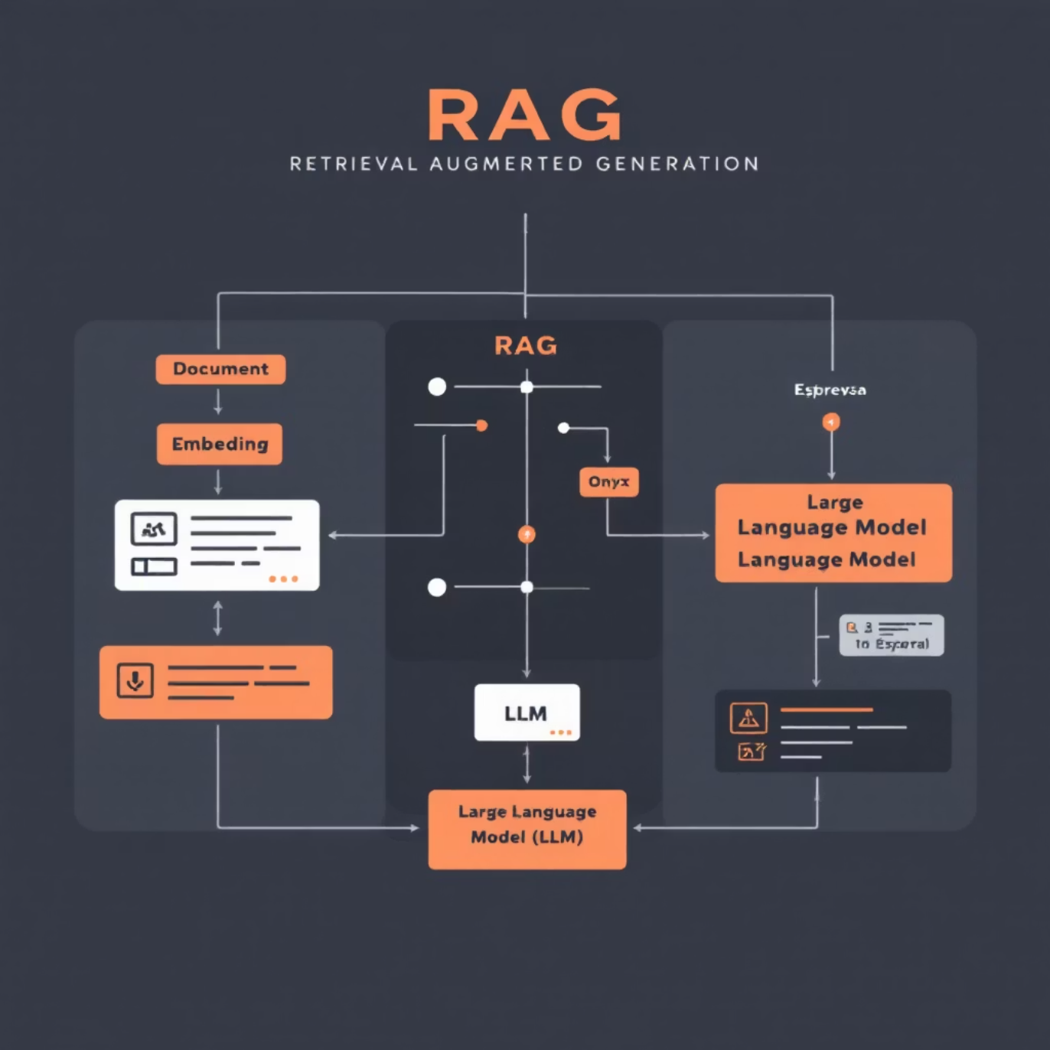
RAG Experiments (Early)
1
Retrieval Focus
Sentence-transformer variants for semantic search; initial baselines (e.g., MiniLM) for speed/quality trade-offs.
2
Indexing Plan
Clean abstracts/snippets → chunking policy → embedding → upsert to vector DB (FAISS/Chroma/Qdrant/Mongo Atlas Vector).
3
Search Knobs to Tune
Top-k, score normalization, MMR/diversity, max context tokens per turn, citation formatting.
4
Chat Integration
Next Steps
Token-budgeting in prompt builder; retrieval-first prompting for citation-aware answers; guardrails for clinical safety.
Small golden set for retrieval quality
Compare encoder families (MiniLM, MPNet, med-domain models)
Latency profiling

Slide 6

Evidence, Artifacts & What's Next
Evidence/Artifacts
Planned (near-term)
Processed JSONLs (train/val/test)
Augment and keep training with alternation experiments on techniques (e.g., LR, Early Stopping)
Add compact MCQ eval (A/B/C/D parse) on held-out PubMedQA
Checkpoints
Generate 1–2k teacher KD batch targeting weak areas
Push cleaned snippets into RAG indexer
training_log.json, loss curves PNG
Commit exact cmds/env files for audit
Configs, convert_merge_split.py, finetune.py

